Slide 1
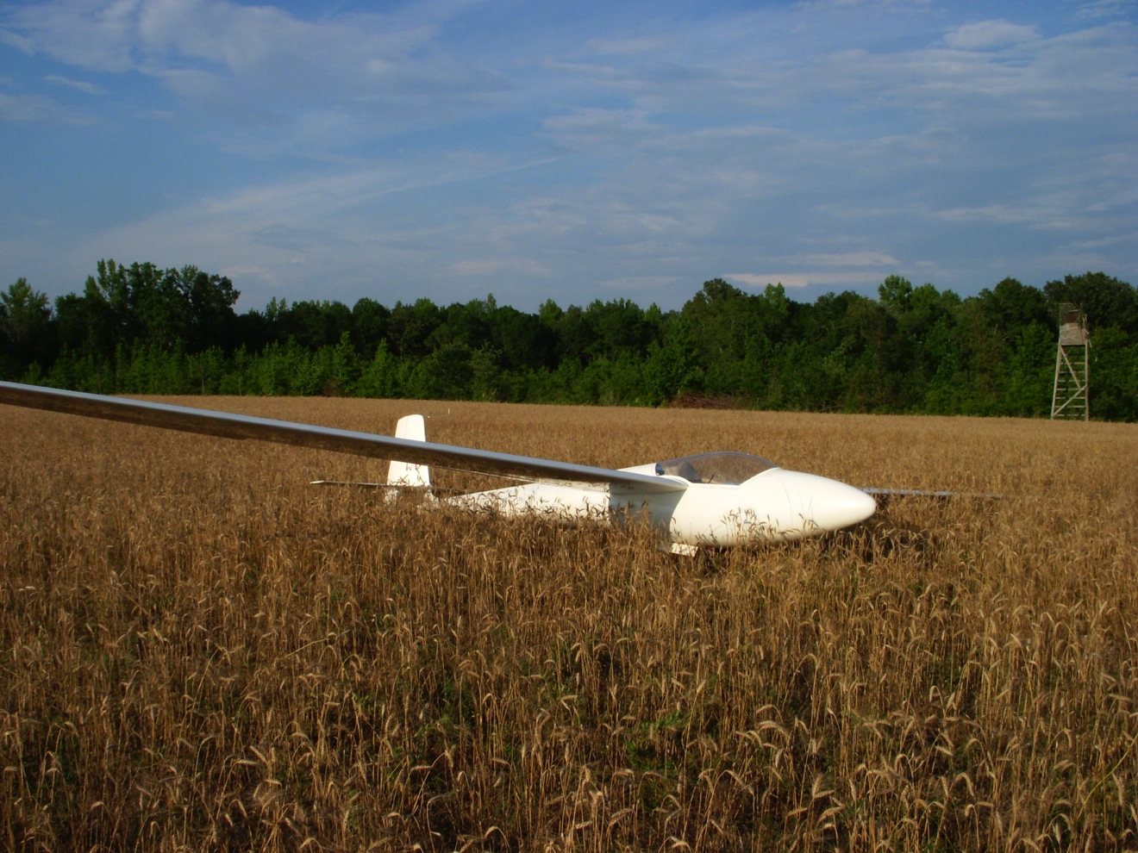
Off-Airport Landings
Thanks to Tim Wells for developing this presentation and making it available to the soaring community
Additional photos by Wally Berry, 2018

Slide 2
Waverly Hall

Slide 3
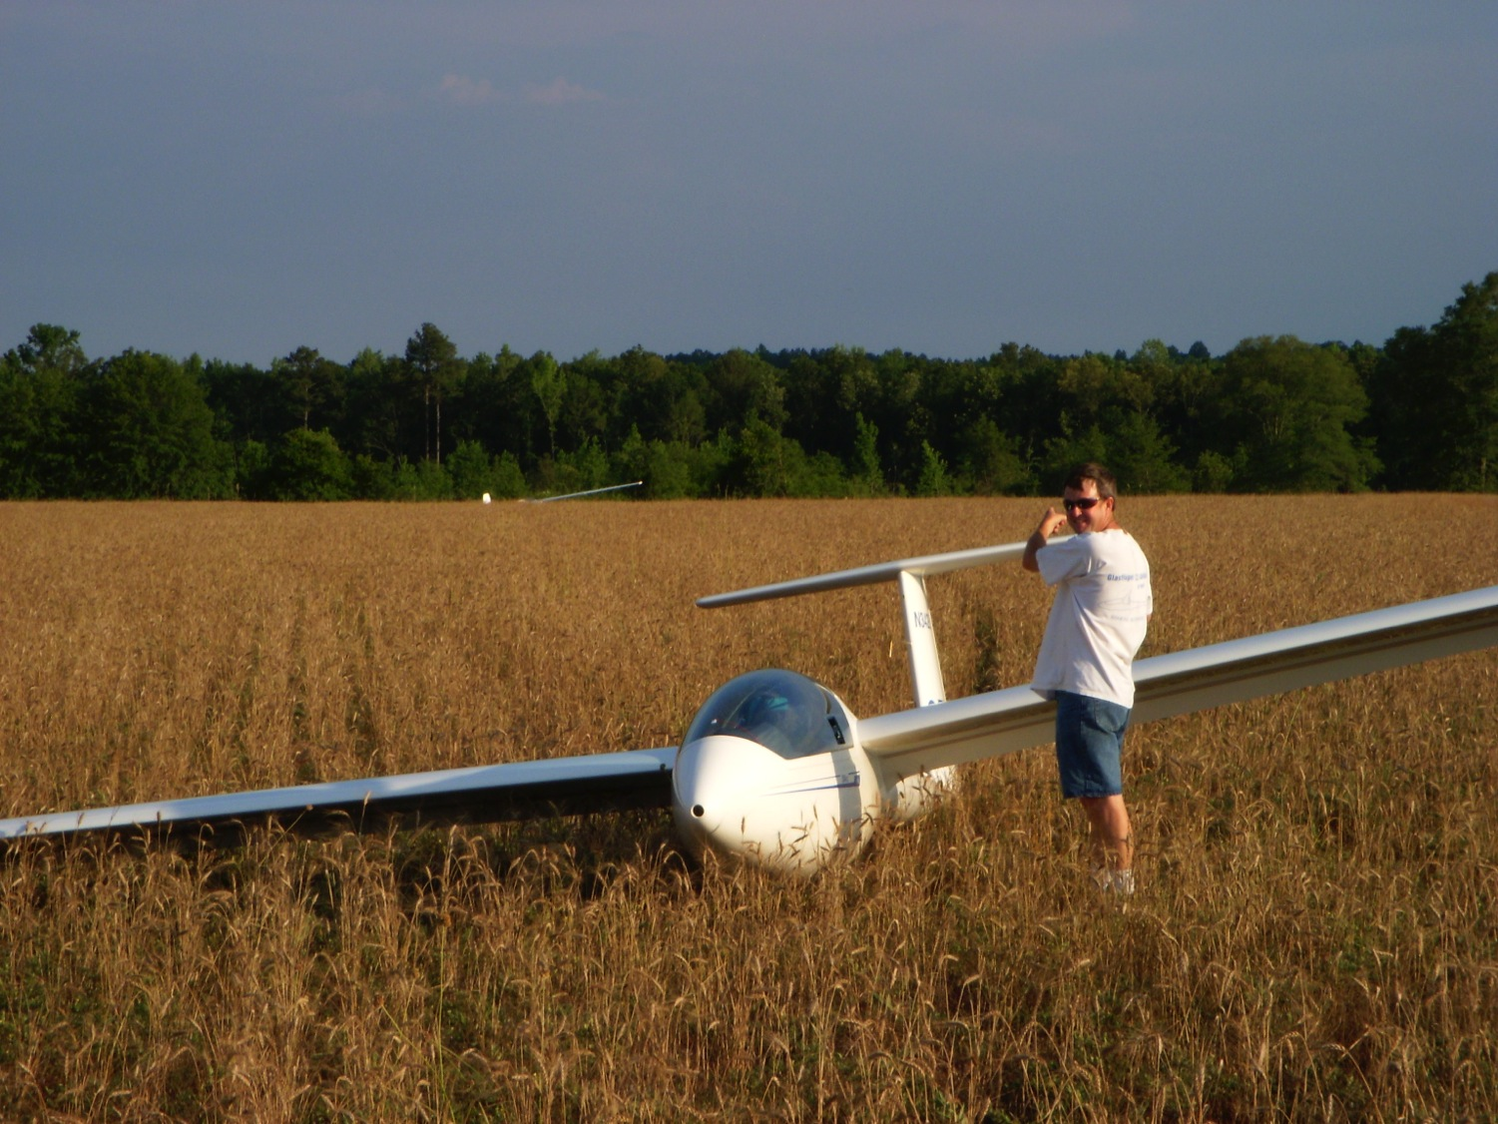

Slide 4
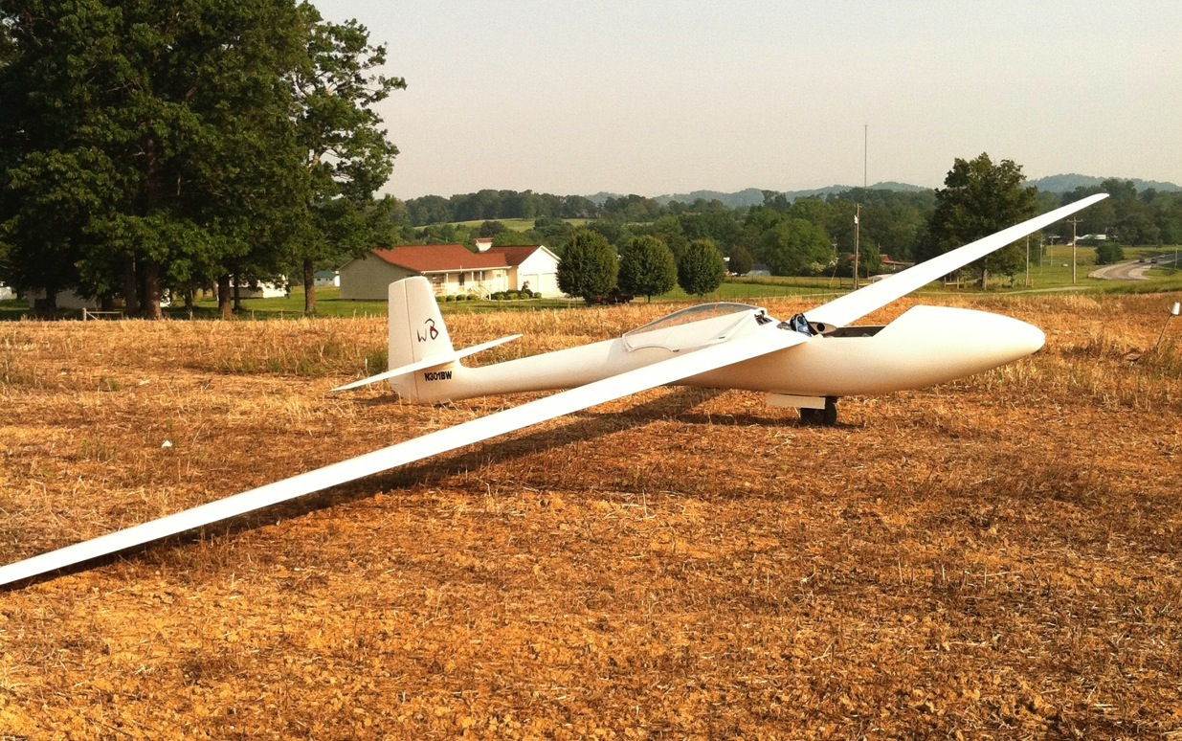
Chilhowee

Slide 5
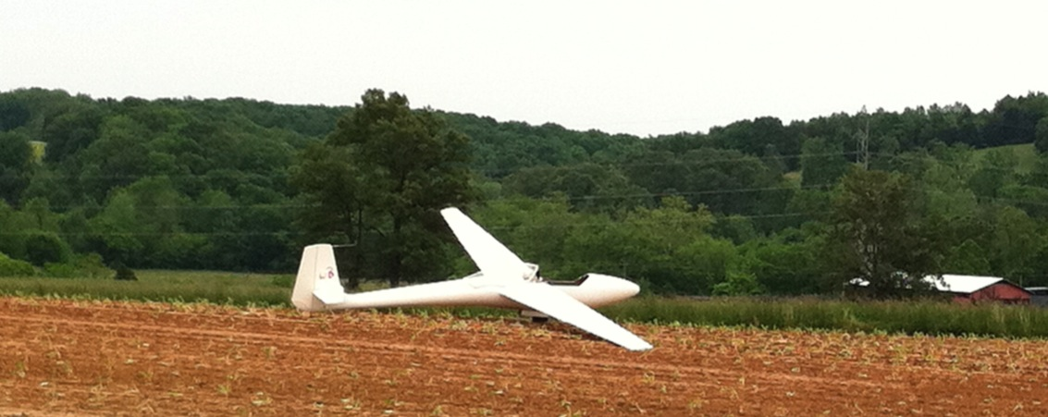
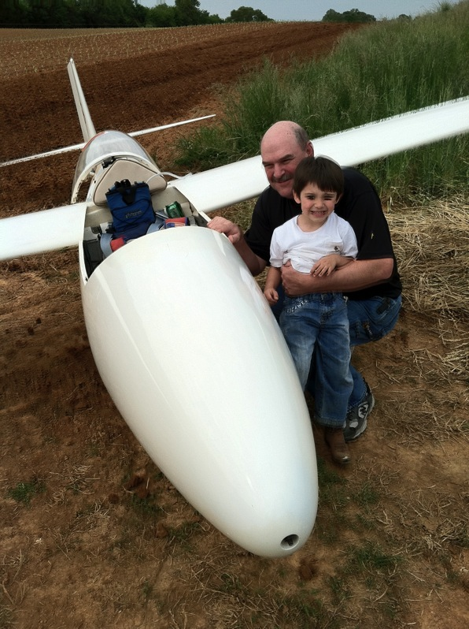
Chilhowee
(same contest)

Slide 6
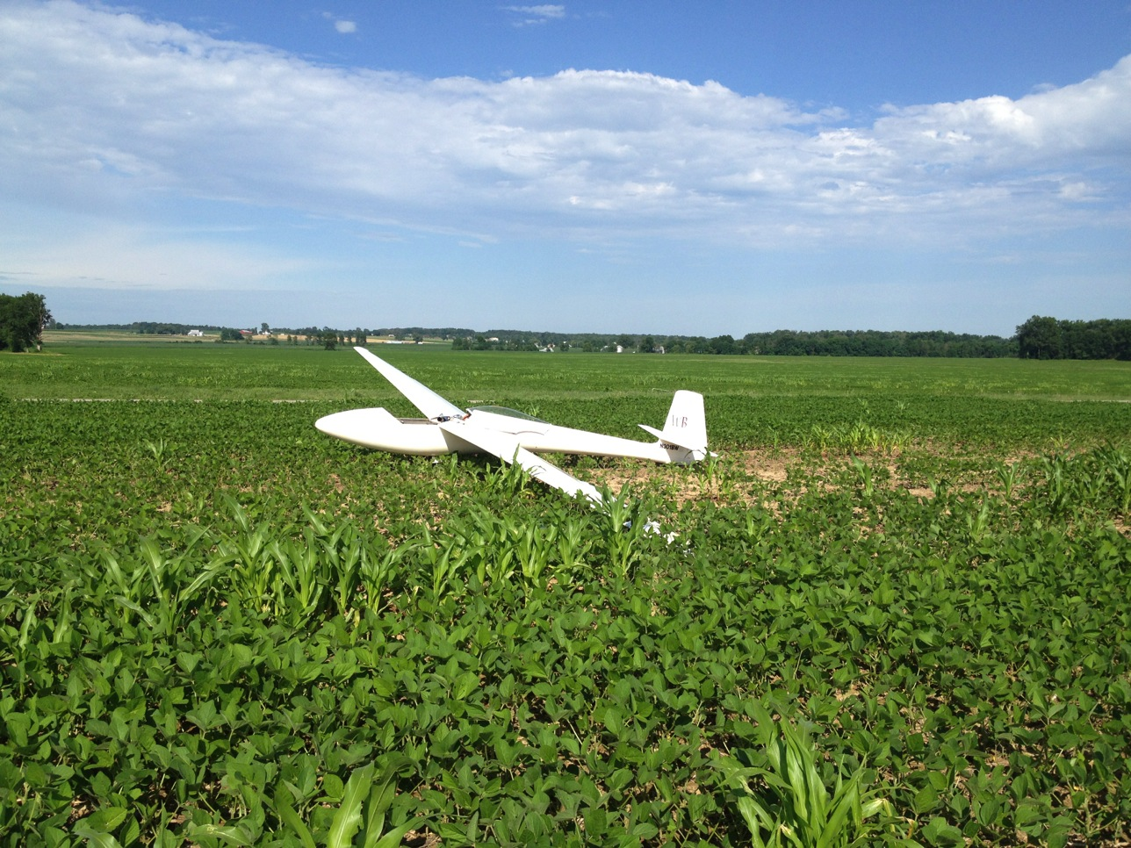
Caesar Creek

Slide 7
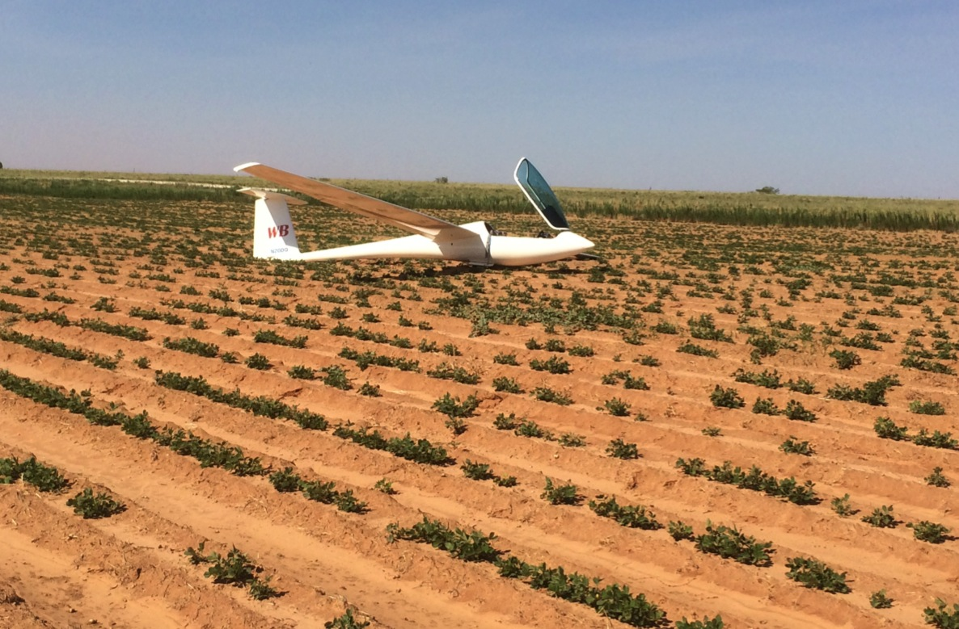
Hobbs

Slide 8
If you fly cross country, sooner or later, you will land out!
The results of your first few land outs will have a profound effect on your future in soaring
Failure – painful and discouraging
Success – while disappointing, can be encouraging
Preparation and practice WILL have a profound effect on your chances of success
Trial and Error approach not recommended

Slide 9
What is Landing Out?
Landing somewhere other than where you started
Landing somewhere other than where you planned to land before the start of the flight

Slide 10
Where can Land Outs Occur?
Another airport
Farmer’s field
Lawn next to a girl’s school
Road
Lake
Trees
Island in a river

Slide 11
Key Skills Required
Situational Awareness
  Landing Options (varies with altitude)
  Field Selection
Precision Landings
Airspeed Control
Situational Awareness
  Thinking ahead

Slide 12
A Test Will Follow This Presentation
Your first (or next) off field landing!

Slide 13
Decision Points and Situational Awareness
Aware of lift conditions around you, ahead, and behind.
  Is the day getting stronger, weakening, potential storms building?
  Wind
  Pay attention to terrain. Know where landable airports and fields are (around you, ahead, AND behind!)

Slide 14
Decision Points and Situational Awareness
Rules of thumb:
  3000 agl and above
    Keep
  3000 agl down to 2000 agl
    Have potential landing areas identified (frequently ask yourself “Where would I land if I had to land now?).
  2000 agl down to 1000 agl
    Have best landing site(s) picked out. Continue to search for lift but stay within gliding range of

Slide 15
Major Hazards
Wires
Slopes
Fences
Wires

Slide 16
Other Hazards
Rough terrain
Ditches, roads
Field too small
Wind
Difficult Approach
Narrow Runway

Slide 17
Major Hazards
Wires
Slopes
Fences
Wires

Slide 18
Major Hazards
Wires
Slopes
Fences
Wires

Slide 19
Field Selection
Altitude High
  General landable terrain awareness
  Airports in GPS Database

Slide 20
Field Selection
Low Altitude
  Airport (maybe)
  Wires
  Wind/Slope
  Field Size
  Surface/crops
  Approach
  Ease of retrieve (least important)

Slide 21
Field Selection
Wires (invisible from above!)
  Between two poles
  Between a pole and trees
  Between a road and a house
  Above or along any road
  Going to any kind of building
  Anywhere crossing a narrow field

Slide 22
Field Selection
Sloped Field
  Always land up hill, regardless of wind
  Slope only visible when viewed from 90 degrees to landing direction
  Landing up hill, carry extra speed, close spoilers in flare
  Turn 90 degrees at end of rollout so glider won’t roll backwards down the hill
  Landing across a slope not recommended

Slide 23
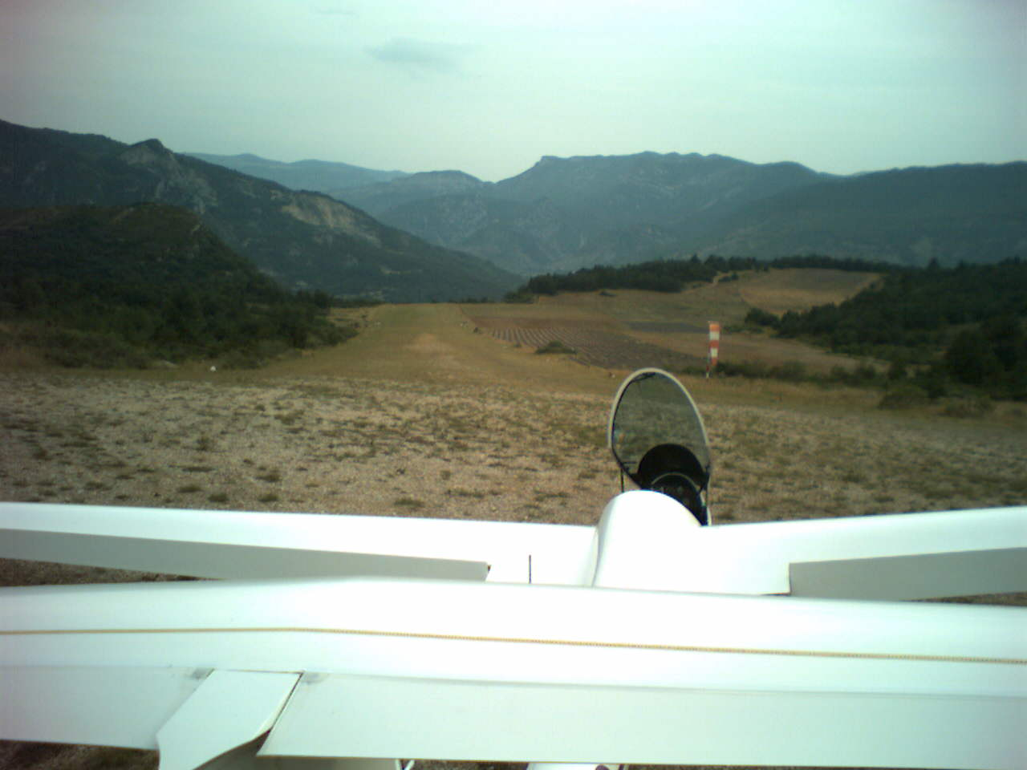

Slide 24
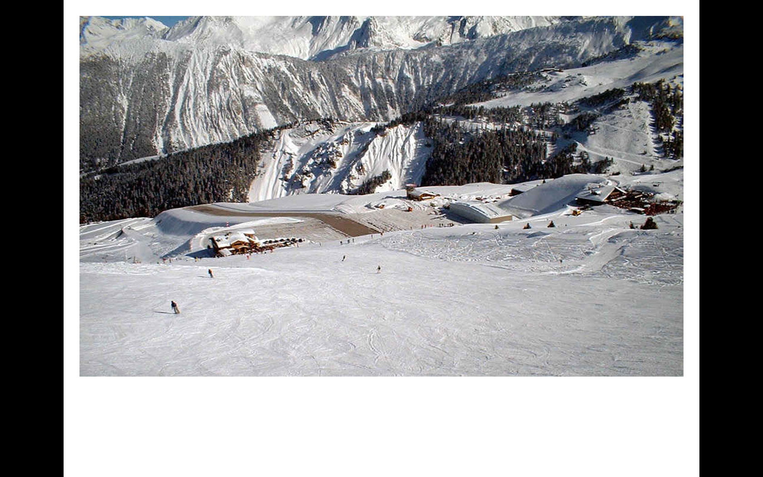

Slide 25
Field Selection
Wind Direction
  GPS, smoke, lake surface, cloud shadows, waves in tall grass or crops
  Parallel to narrow valley between two ridges
  If you are not sure, probably doesn’t matter
Always land into the wind (unless)
  Light winds, difficult approach down wind end
  Sloped field

Slide 26
Field Selection
Surface/Crops
  Freshly mowed hayfield best (no hay bales)
  Low crops (alfalfa) OK
  Freshly cultivated fields OK, but ground roll will be short. Look out for rocks.
  Avoid plowed fields if possible
  Avoid high crops, especially corn (if only option, flare and touch down at top of crop.
  Avoid pastures (rocks, animals)
  Discontinuities, wet areas

Slide 27
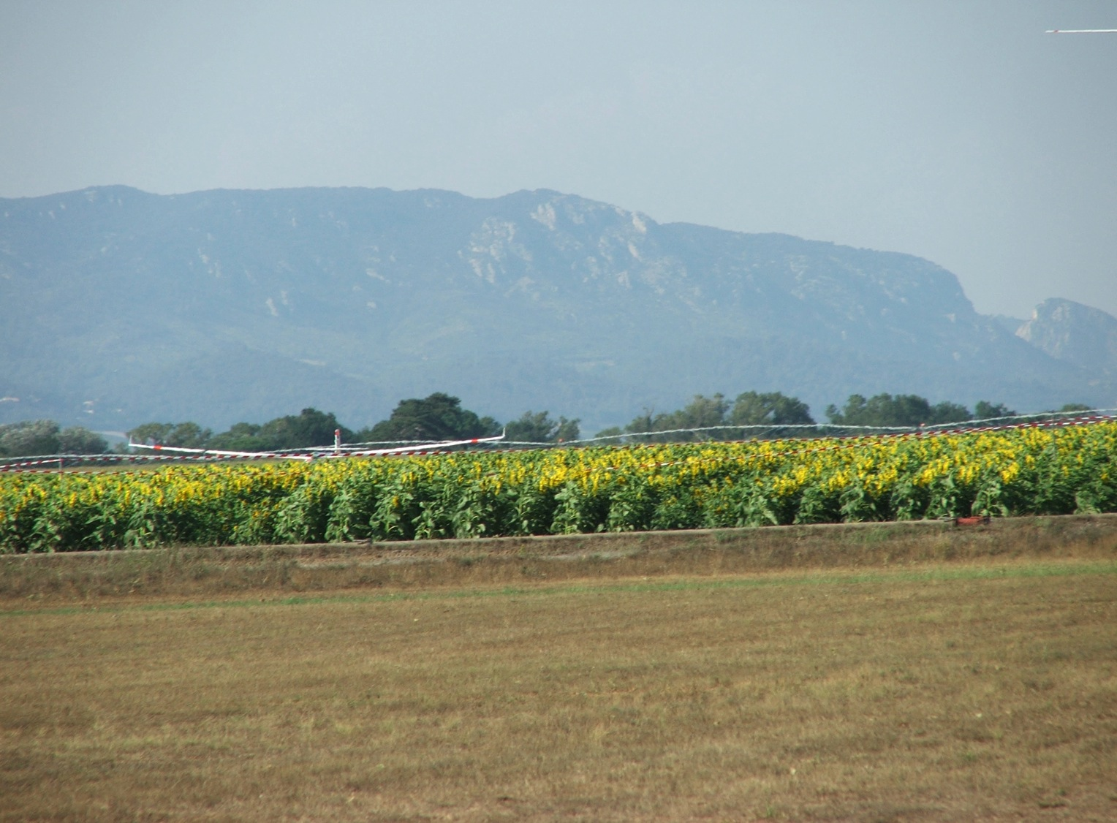

Slide 28
Field Selection
Do not rely on small private airports you have not personally inspected or someone you trust has not recommended
Assumption: GPS says there is an airport you can reach at 500 feet agl.
Reality:
  Airport closed
  Runway too narrow
  Runway lights
  Owner hasn’t mowed the field all year
  GPS says it’s there, but I can’t find it!

Slide 29
Outlanding Procedure
Select several options by 2000 feet agl, radio off
Select best field by 1200 feet agl
Gear down,
Fly full pattern at correct airspeed
Use downwind to inspect field for rocks, holes, ditches, etc.
Plan to touch down well into field
If too high, use reverse pattern (never 360)

Slide 30
Outlanding Procedure
NEVER change your mind once committed to the pattern
If winds greater than 15 kts, expect turbulence
Touch down with minimum energy
But, watch out for wind shear
Stop as quickly as possible

Slide 31
Outlanding Procedure
Be flexible
  Short field? Land on diagonal
  Rolling surface? If possible land on a crest
  High trees on approach, but not for the adjacent field, which is unsuitable for landing? Fly around the trees and then line up for your chosen field on a diagonal.

Slide 32
After Landing
Move glider clear so others can land
Relations with landowner
  If possible, contact landowner
  Apologies, thanks
  No matter what, be polite
  Don’t be too quick to offer payment for crop damage, but be agreeable to a reasonable payment
Dealing with the curious public
  Don’t let them cause further crop damage
Retrieve
  Write down lat/long and clear retrieve directions before calling retrieve office!

Slide 33
Preparation at Home Gliderport
Precision Landings (touchdown point and stopping point)
Minimum energy touchdowns
Landing without reference to altimeter (cover it up)
Varied IP altitudes
Experience with different wind conditions

Slide 34
Preparation when not flying
While driving, look at fields, wires, crops, approaches, etc.

Slide 35
Staying in range of landable fields
Use of GPS & glide computer
“Airport hopping”
Just because an airport is in the database….

Slide 36
“Flatland” Outlandings
You can evaluate a field from the air
The field that protects you is in view
Getting to it is simple & obvious

Slide 37
“Mountain” Outlandings
You must know the individual field
Scouting may be necessary
Field may not be visible until nearby
Path to the field may not be direct or obvious

Slide 38
Problem areas
Pastures
Clear Cuts
Roads
Parks & recreational fields
Golf courses
Parking lots

Slide 39
“Crashable” areas
Trees
Water
Sagebrush

Slide 40
“Don’t Do It” areas
Gravel pit
Graveyard
Orchard
Grape Vineyard
Inhabited area

Slide 41
Minimum safe field size – it depends
Approaches, obstacles
Altitude
Wind
Glider
Surface
Pilot’s skill & precision
Ground loop, if necessary (stick forward)

Slide 42
Evaluating size
Narrow looks long – long looks narrow
Wide looks short – short looks wide
Must have some idea about local fields
Relative size of trees, power poles, buildings, etc.

Slide 43
Low Saves
Don’t believe all the stories about 200 foot saves
Radio off
Don’t circle unless you can afford to lose 200 feet
Low thermaling: coordinated turns plus 5-10 kts extra airspeed
Steeper banks better than shallow
Head out of the cockpit
Wait for a thermal on a ridge with good field in reach
Low experience, currency? Give it up at 800 feet

Slide 44
Low Saves (with an engine)
Have a good field as a backup to the engine
What altitude to start the engine?
  When did the engine last run?
  Good field available?
  Current in glider?
If the engine does not start, FLY THE GLIDER!

Slide 45
Survival issues
Mobile phone
ELT use
Radio
  Other gliders 123.30
  Airliners 121.50
Survival kit

Slide 46
Summary
Landouts are more risky than landing at the home airport, but with planning and preparation, they need not be excessively so
Prepare, practice, plan, discipline
Getting home always beats almost winning the day, but landing five miles short.

Slide 47
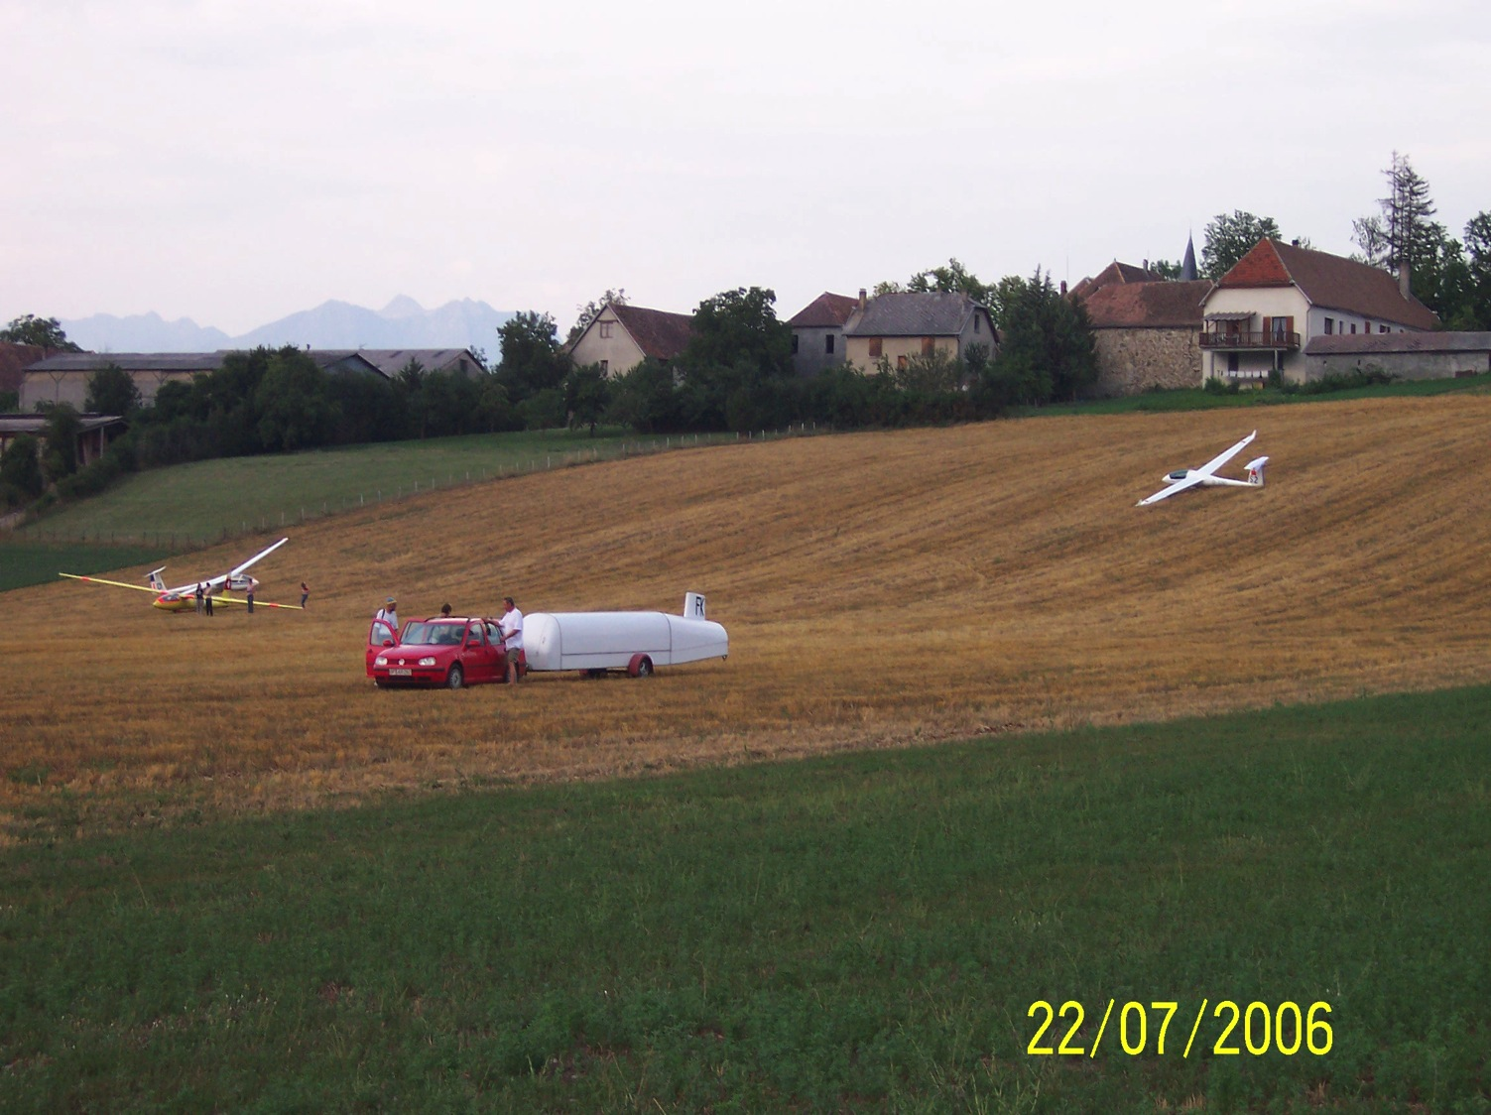
Good Luck!
Fly Safe!

