Slide 1
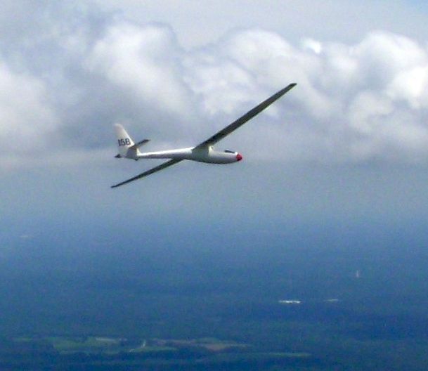
Prerequisites for XC Soaring
Wally Berry, 2018

Slide 2
Prereq’s for XC Soaring
1. Glider
2. Transport
3. Crew

Slide 3
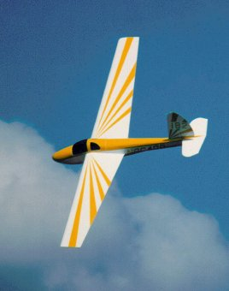
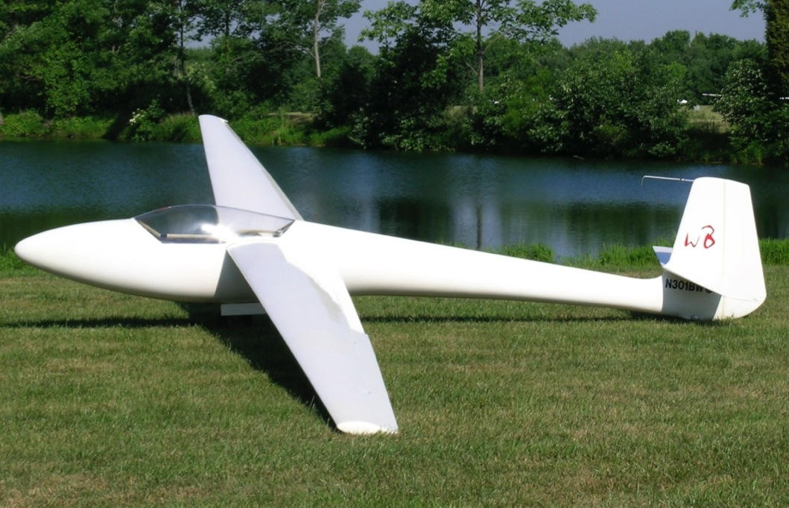
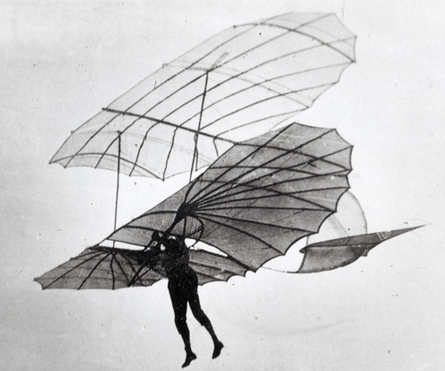
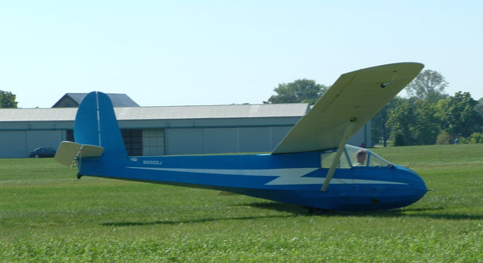
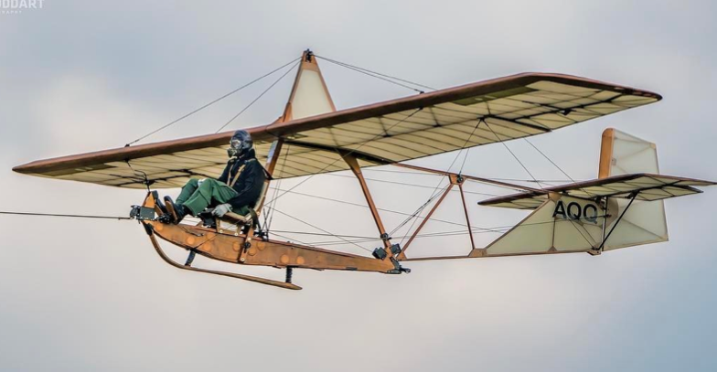
Prereq’s for XC Soaring
First you get a glider:

Slide 4
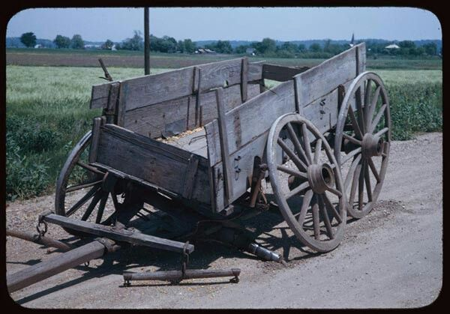
Transport

Slide 5
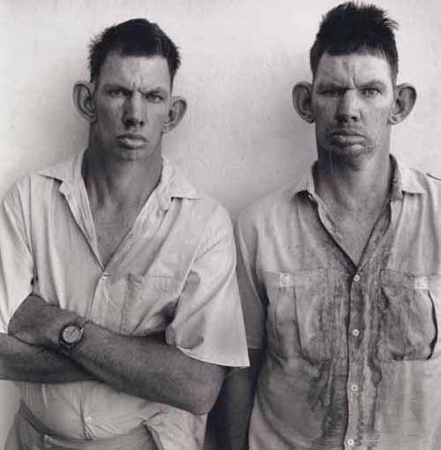
Crew

Slide 6
Prereq’s for XC Soaring
Altitude
Airspeed
Intelligence
Two out of three of these are needed for successful completion of a xc soaring flight!

Slide 7
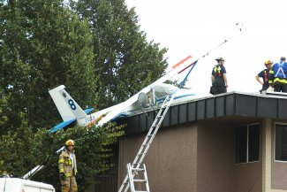
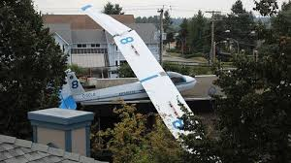

Slide 8
Prereq’s for XC Soaring
What you really need:
Training
Experience
Practice

Slide 9
Prereq’s for XC Soaring
How to get?
SSA ABC, Bronze badge program!

Slide 10
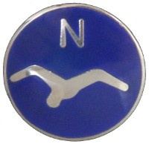
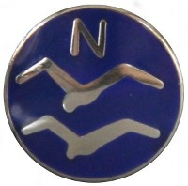
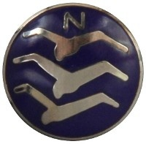
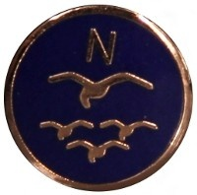
Training, Experience, Practice

Slide 11
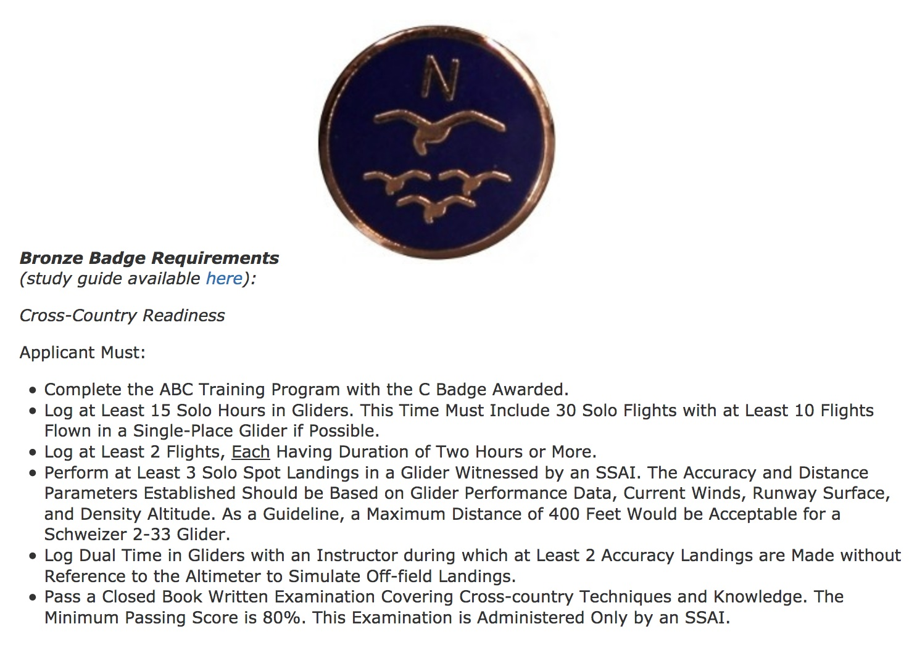
Prereq’s for XC Soaring

Slide 13
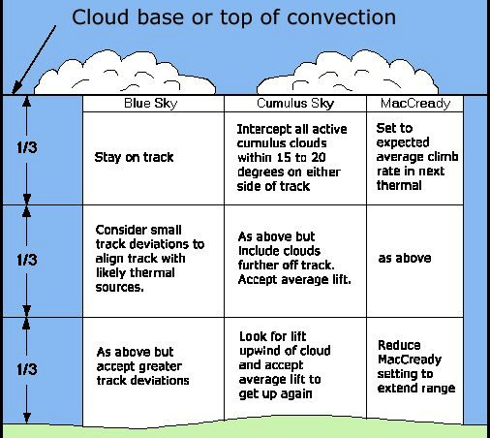
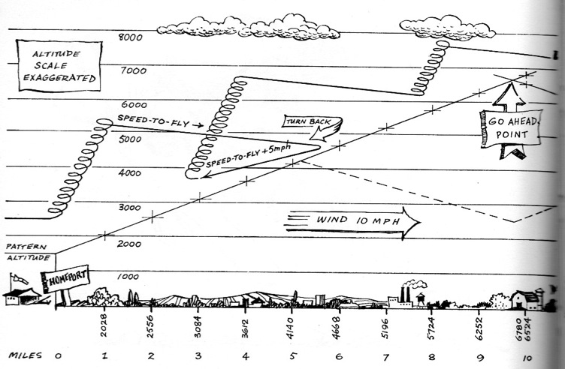
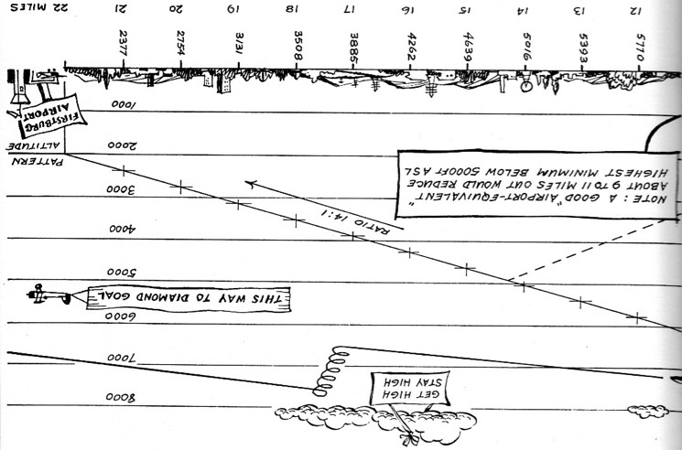
Read…

Slide 14
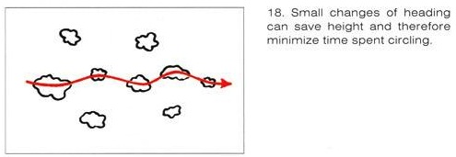
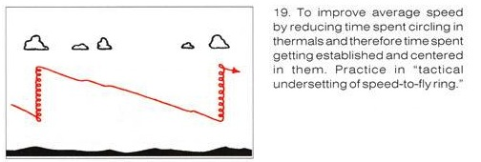
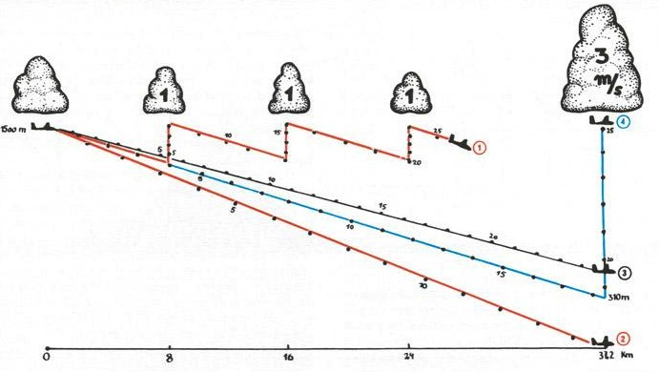
Read more…

Slide 15
My two favorite books

Slide 16
Two new books that are good

Slide 17
And, two more books

Slide 18
And, two more books

Slide 19
Additional Skills
Beyond what is covered in the SSA ABC, Bronze program:
Gaggling
Final Glides

Slide 20
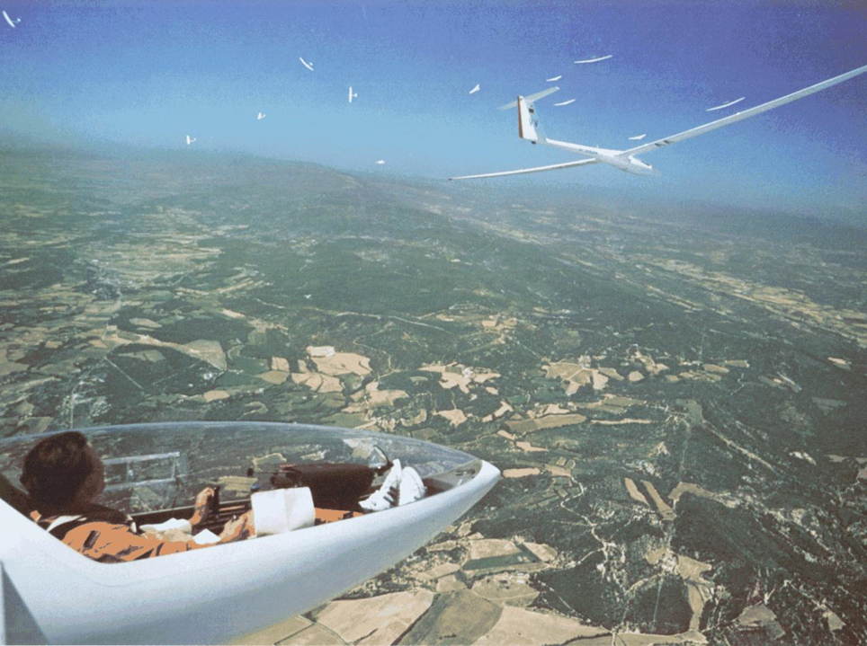
Gaggles
Notes:
A lot of gliders in 1 gaggle

Slide 21
Gaggles
Gliding Safety Videos 1 Cutting In https://www.youtube.com/playlist?list=PLg2FFq0MZjiyNkbxgE0RvDrQ1Z8QvGktZ
Notes:
Pilot number two is allowing the glider to cut into the turn. A small mistake that quickly becomes very dangerous. Never cut in a turn behind another glider.
The purpose of these clips is as an instructional aid for situational awareness and as a base for flight safety discussions. The clips were made using the gliding simulator Condor Soaring.

Slide 22
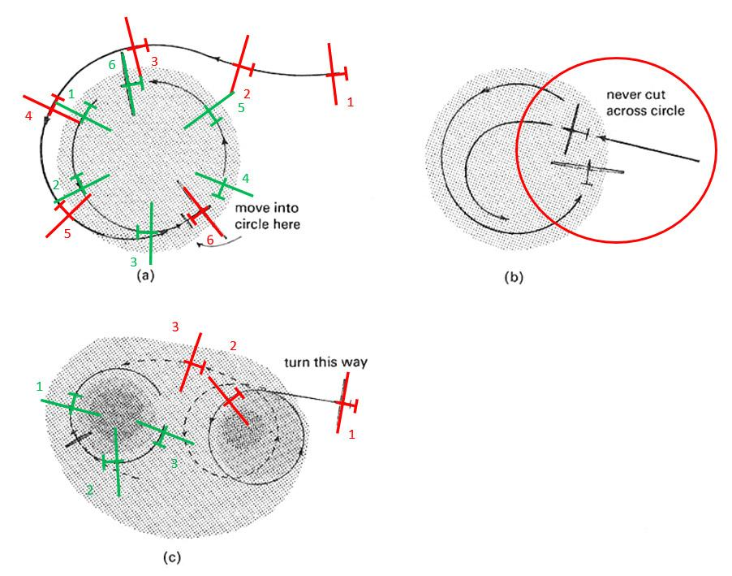
Joining Gaggles
(a) Always join outside their circle and only move in when on the opposite side.
[Notice when red glider is at position 6 the green glider is 180° across circle]
(b) Never join by cutting across another pilot’s circle or pulling up into the circle.
(c) Always circle in the same direction as any nearby glider to make joining each other safe and simple.

Slide 23
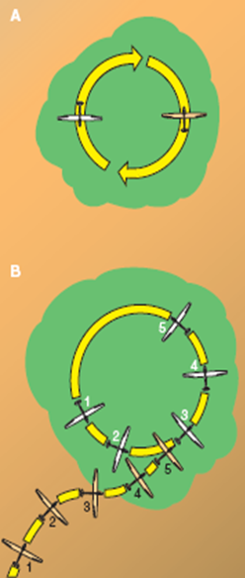
Joining Gaggles
•Enter from the side, don’t aim for the middle
•Vary your bank to fit yourself in
•Turn in the same direction of the first sailplane in, usually above
•Avoid just above or just below positions
•Passing, avoid cutting across the nose of a slow climber
•Don’t bomb through the center upon leaving, no matter what the books say

Slide 24
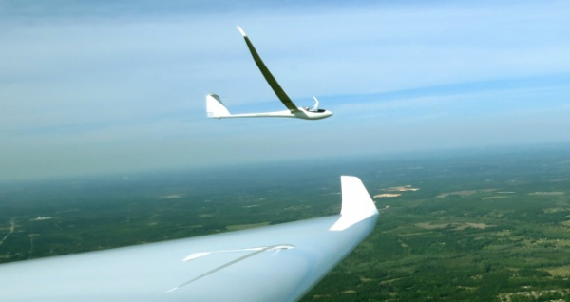
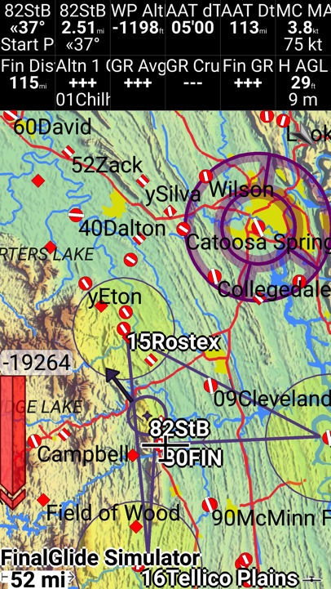
Final Glides
Conservative:
1,000+AGL finish & 3.5+McCready,
Or even more so to start with.
Notes:
Sophisticated final glide computers are nearly universal these days. But simply installing good equipment isn’t enough – make sure you have considerable practice with the device you'll use in the contest. When determining your margins, take your experience and the nature of the terrain into account. Clearly, inexperienced pilots should plan conservative final glides. A surprising number of pilots seem willing to put blind faith in the numbers that their glide computer displays. This is a bad plan: when you're being told you need 800 feet to do the last 18 miles, it's time to be skeptical. Get in the habit of doing occasional cross-checks. The old rule of 5 miles per thousand feet (200‟ per mile) is a good way to check whether glide calculations make sense.

Slide 25
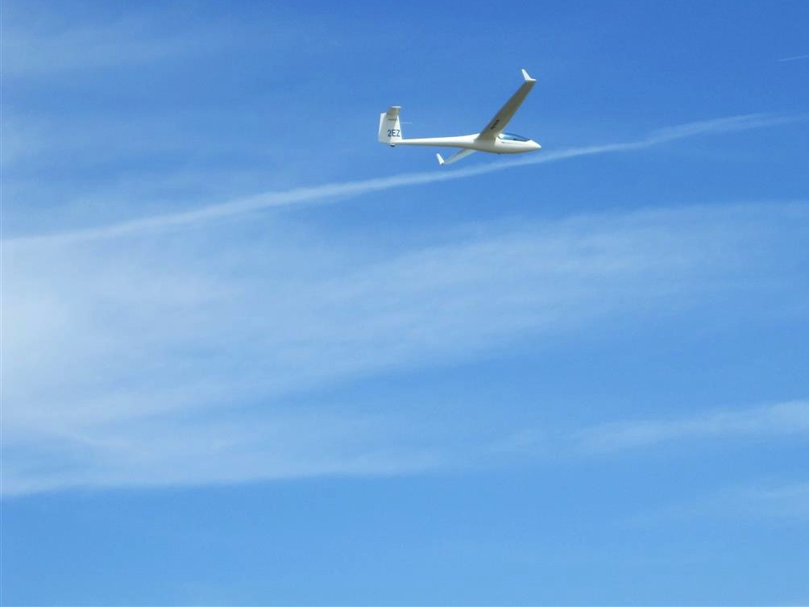
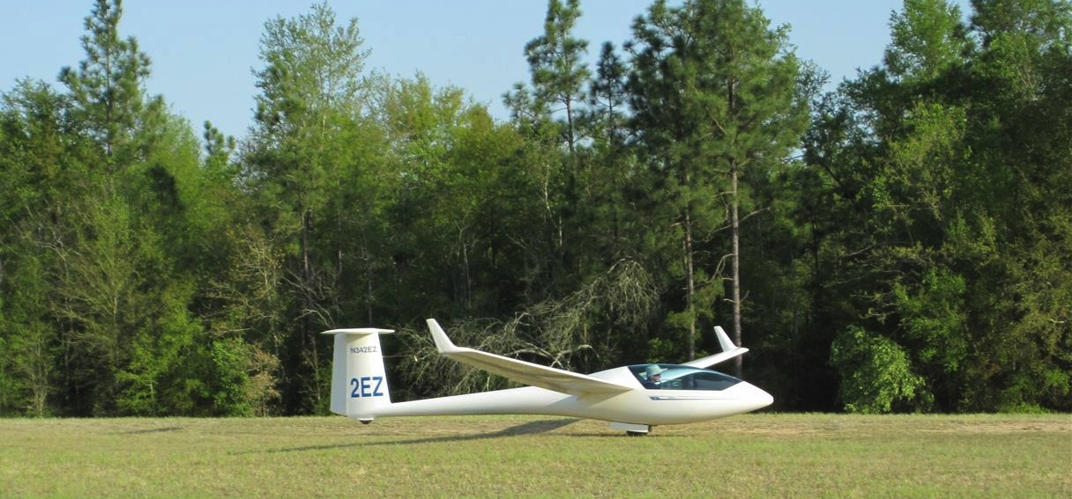
Finish & Landing
Notes:
It can be rapid fire landings, plan to join the pattern, land long or short, get off the runway ASAP.

Slide 26
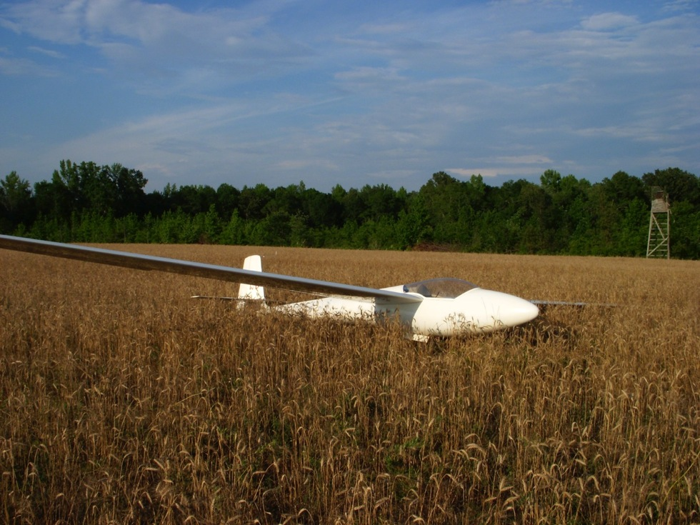
Off-Airport Landings

Slide 27
Waverly Hall

Slide 28
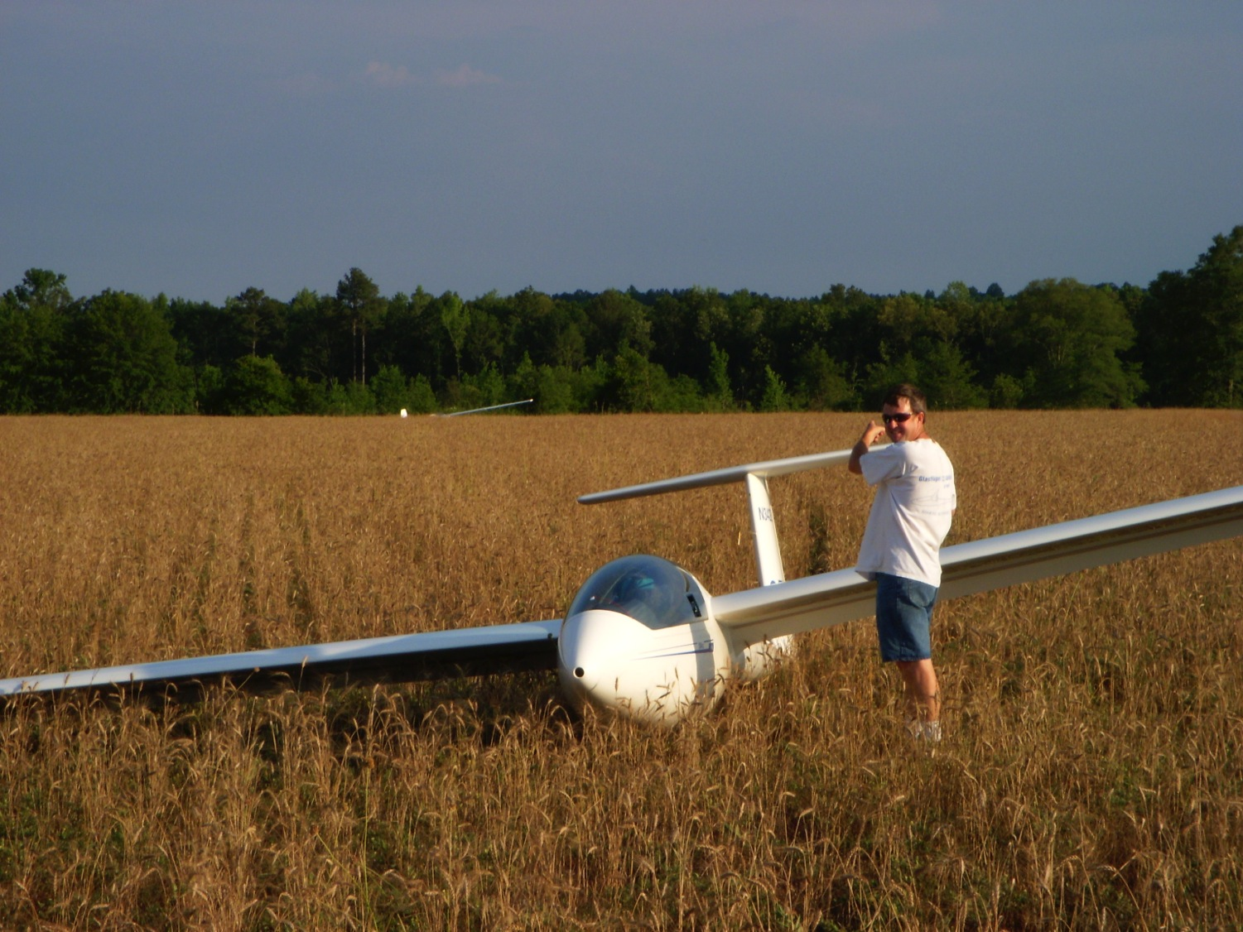

Slide 29
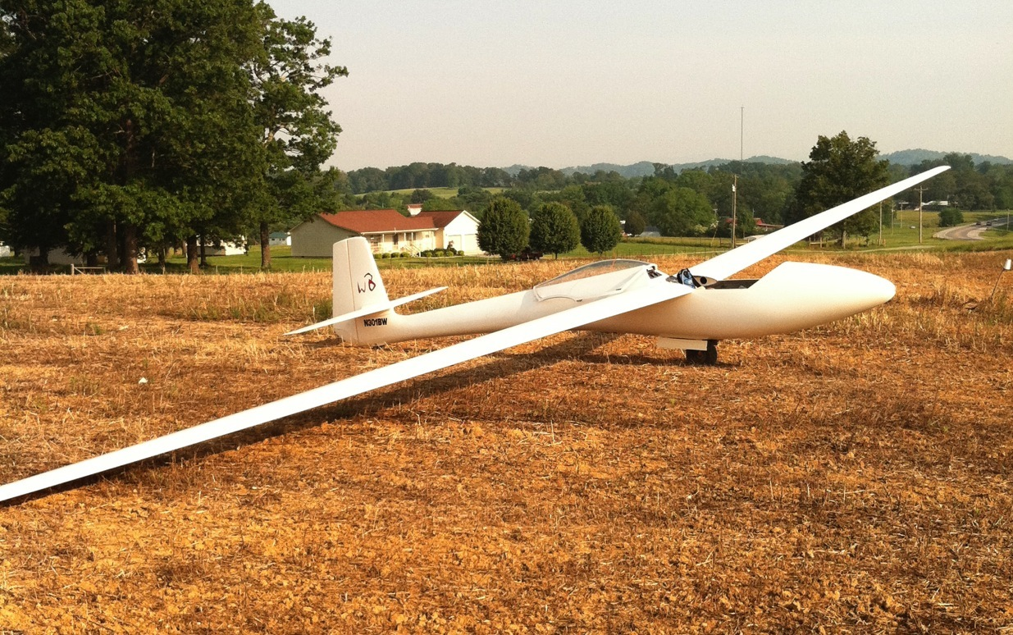
Chilhowee

Slide 30
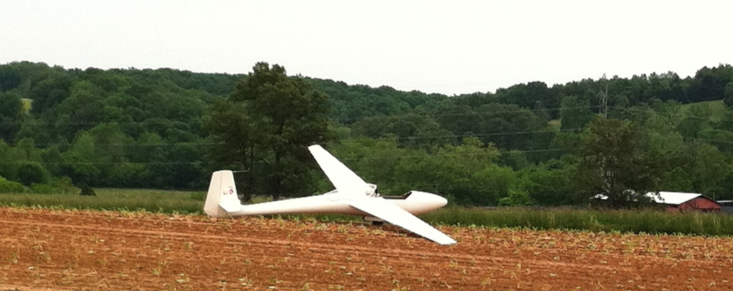
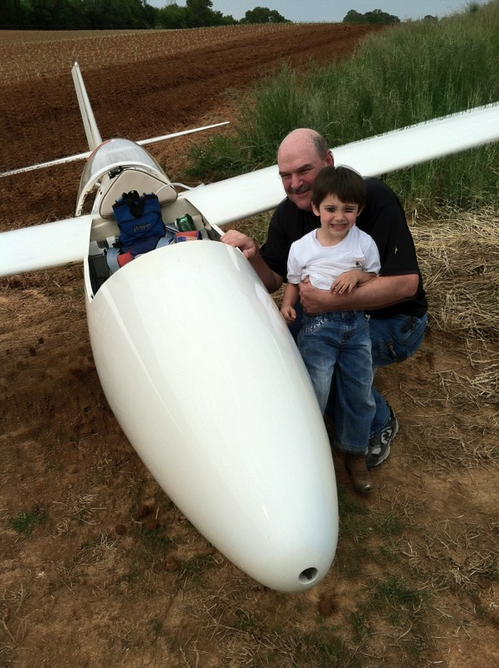
Chilhowee
(same contest)

Slide 31
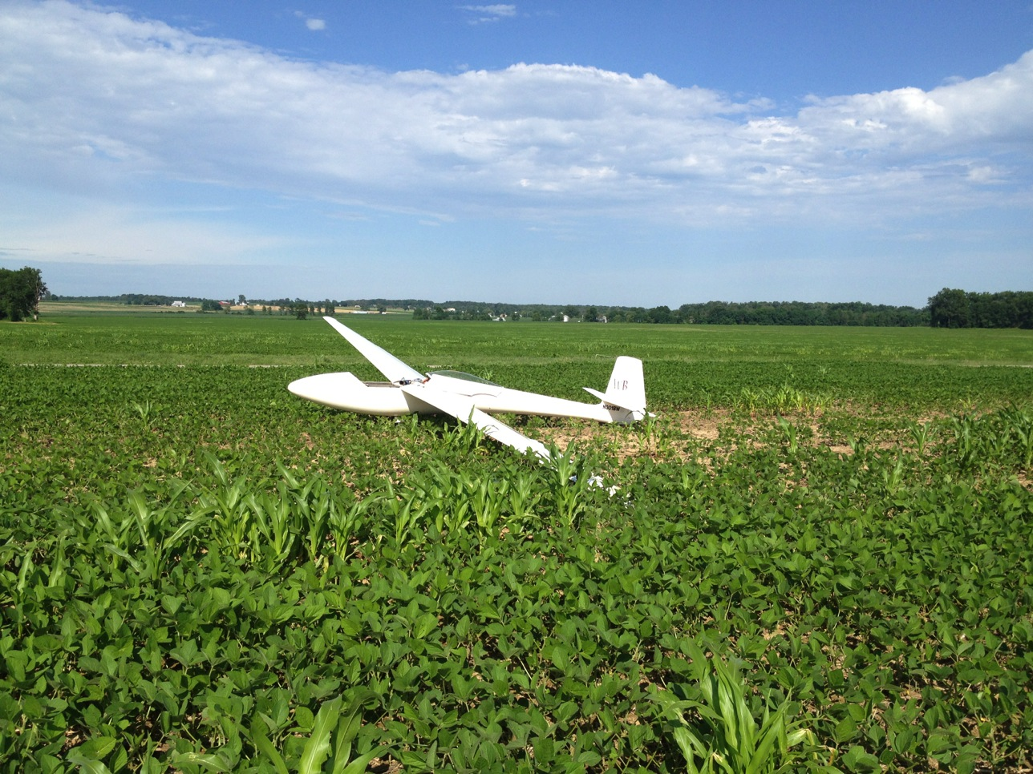
Caesar Creek

Slide 32
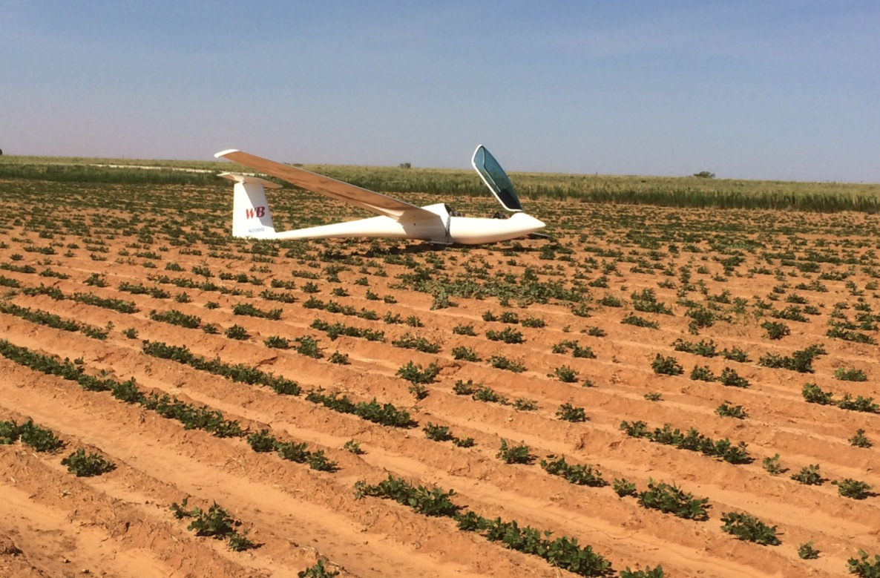
Hobbs

